Slide 1

Deep Learning
DSBA 6190-U90 | Colby T. Ford, Ph.D.

Slide 2
MLOps and Model Operationalization
Azure OpenAI Service
Operationalization
Batch
ADFv2
Realtime Scoring
APIs

Slide 3
Azure OpenAI Service

Slide 4
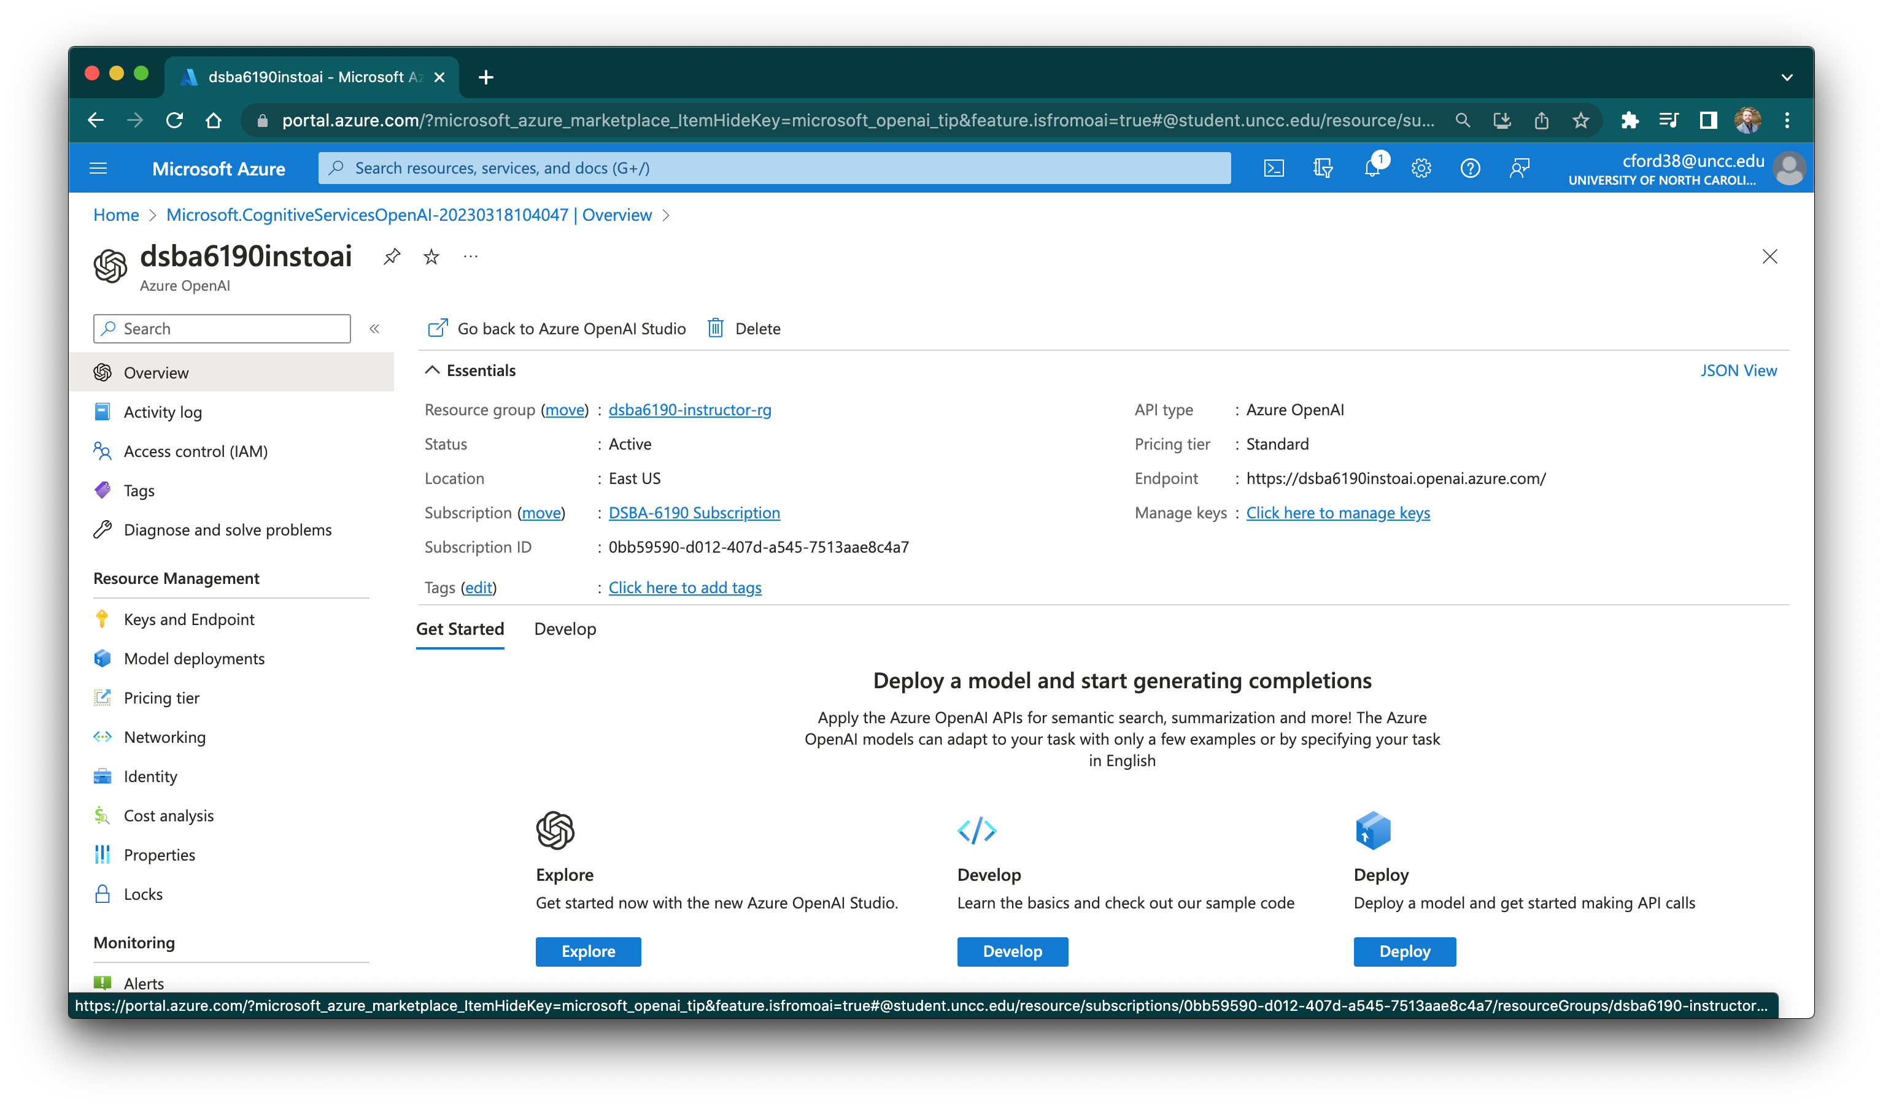
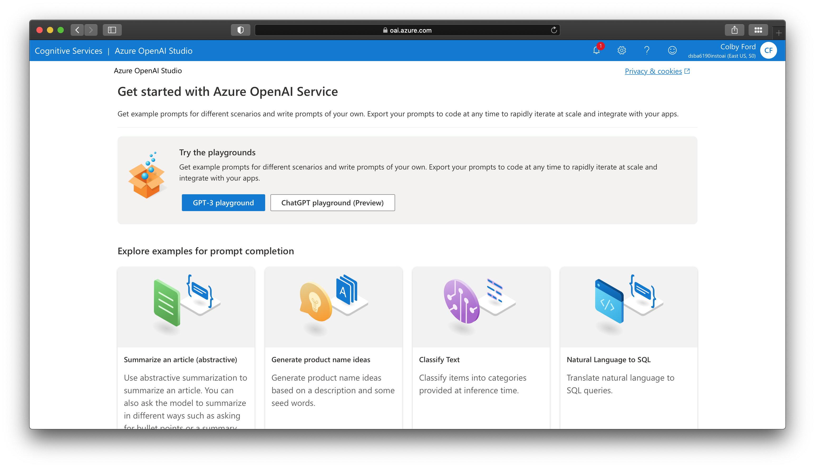
Azure OpenAI Service
Provides access to GPT-3 and ChatGPT (and other models) as API endpoints
Can fine-tune these models for your specific use case.
Example tasks:
Summarize text
Generate new ideas (names, etc.)
Classify test
Generate code
Also includes a DALL-E preview

Slide 5
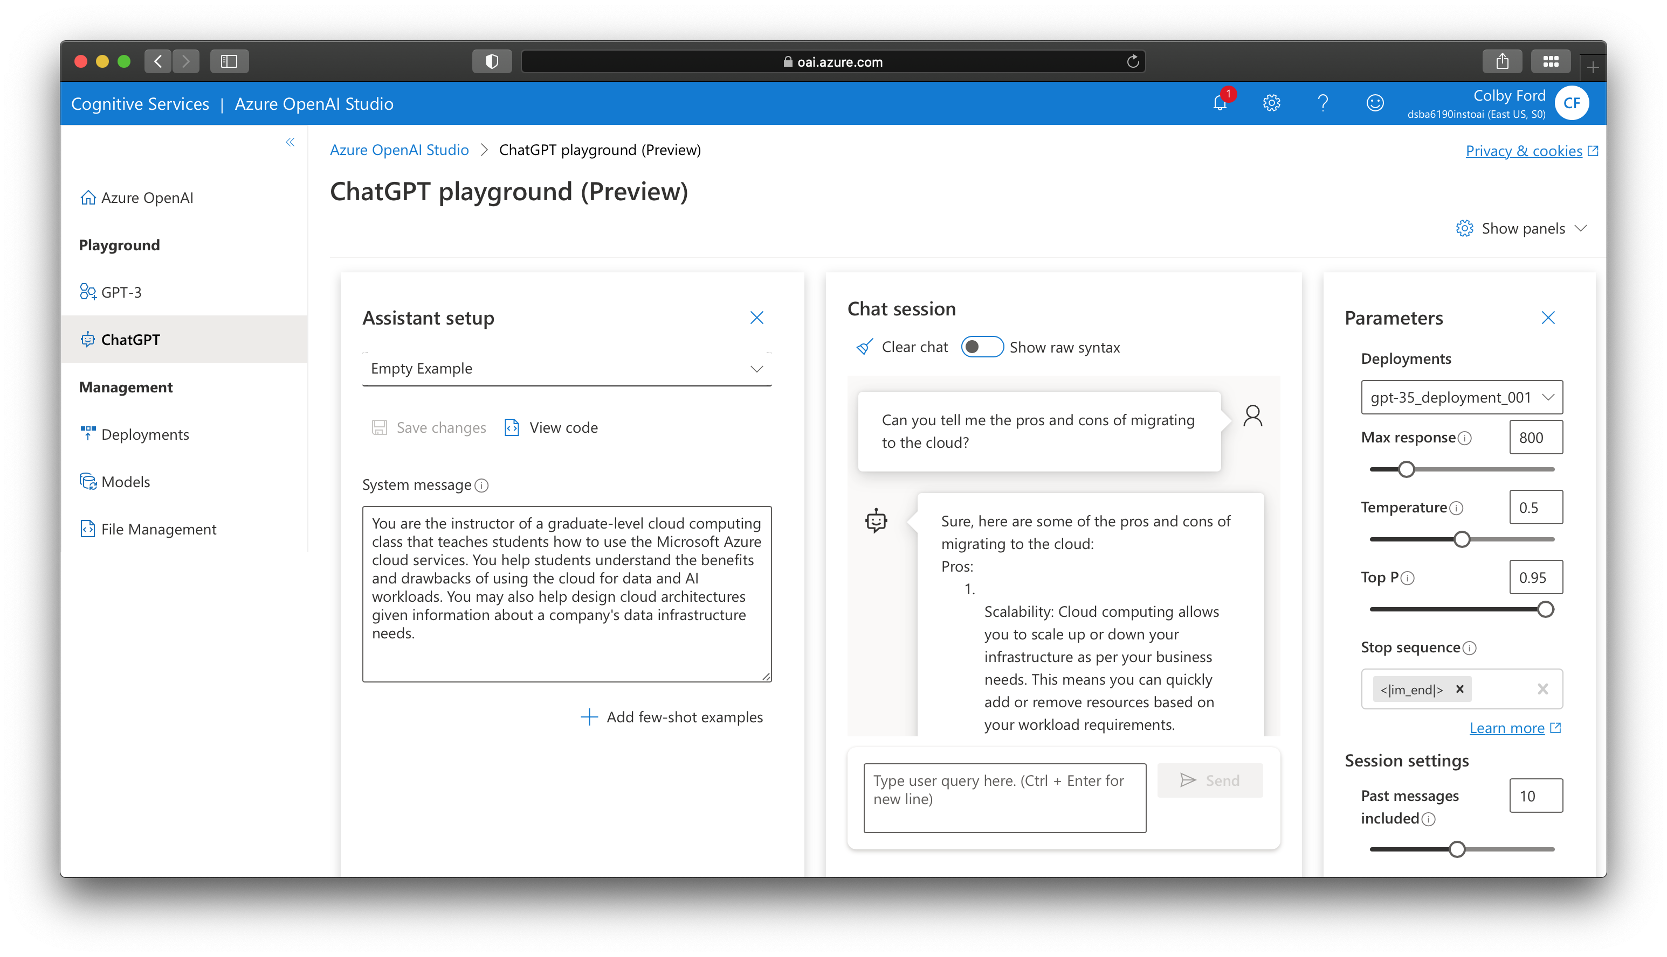
Can ChatGPT Replace Me?!?
Link
Notes:
Prompt: You are the instructor of a graduate-level cloud computing class that teaches students how to use the Microsoft Azure cloud services. You help students understand the benefits and drawbacks of using the cloud for data and AI workloads. You may also help design cloud architectures given information about a company's data infrastructure needs.

Slide 6
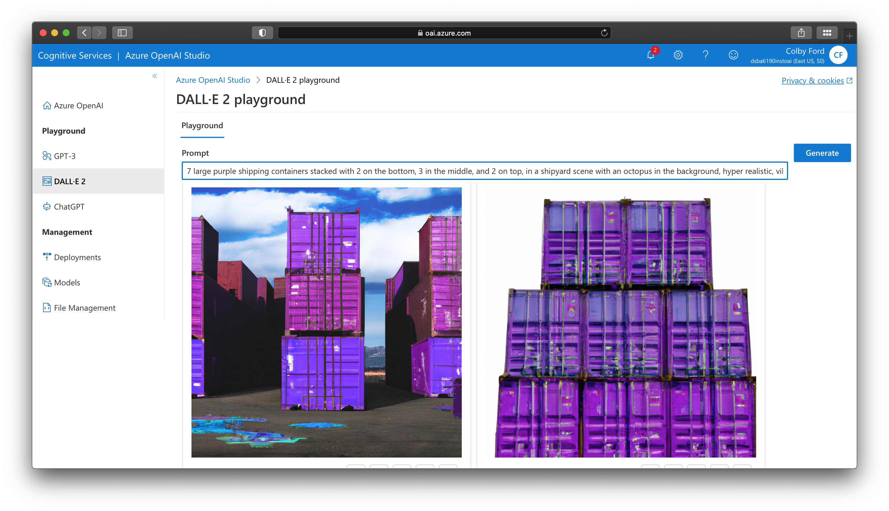
Generating Images in the DALL-E 2 Playground
Link

Slide 7
Operationalization

Slide 8
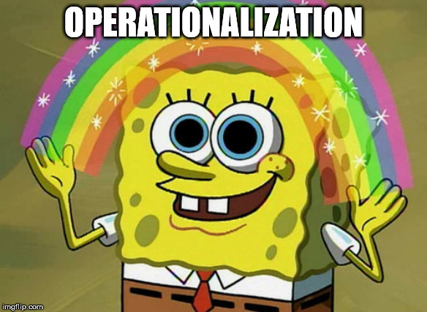
“Now that my client has an ML model that they’re happy with, how do we go about using it in production?”

Slide 9



Options in Azure
Batch Scoring in Databricks
Deployment with Azure Machine Learning
Custom Deployment with Function Apps (or other services)

Slide 10


Batch Scoring in Databricks
Option 1:
Use ADFv2 as the Orchestrator
Option 2:
Use Databricks Jobs

Slide 11
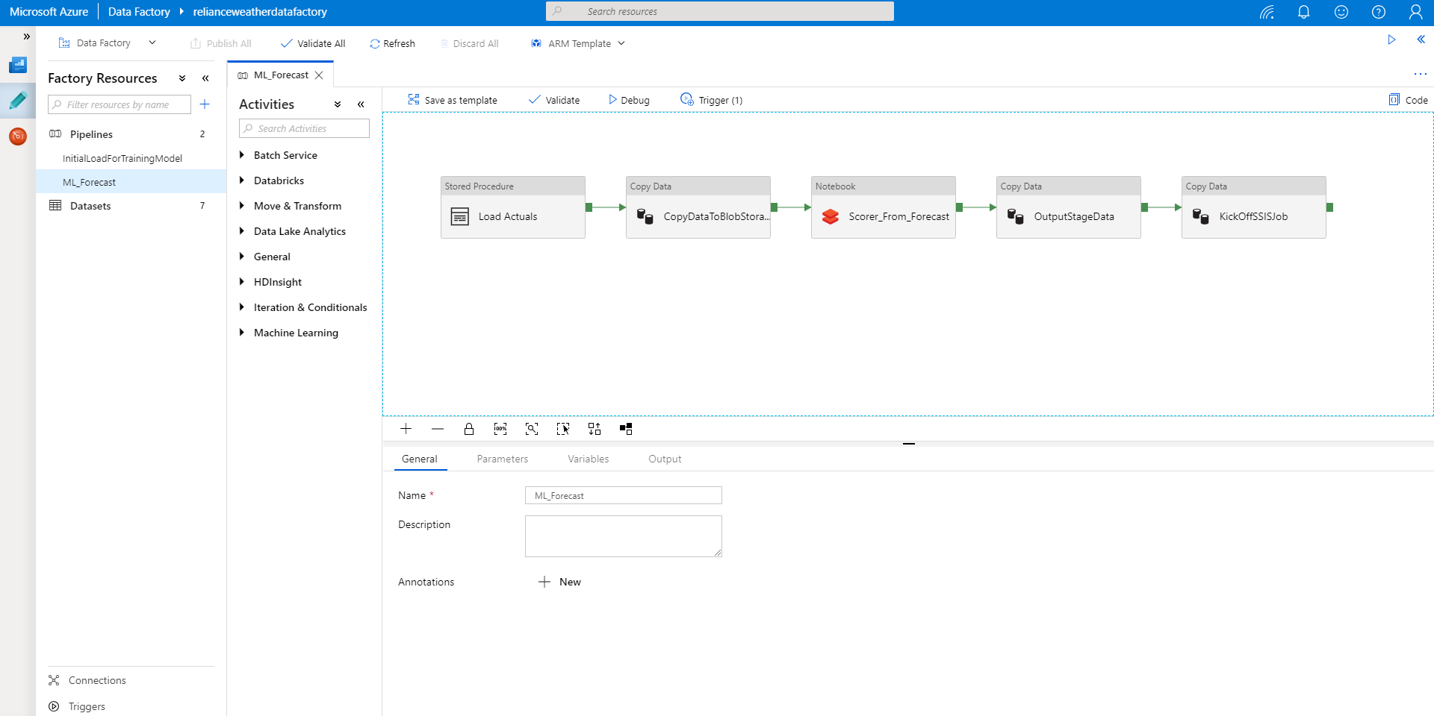
Databricks + Azure Data Factory

Slide 12
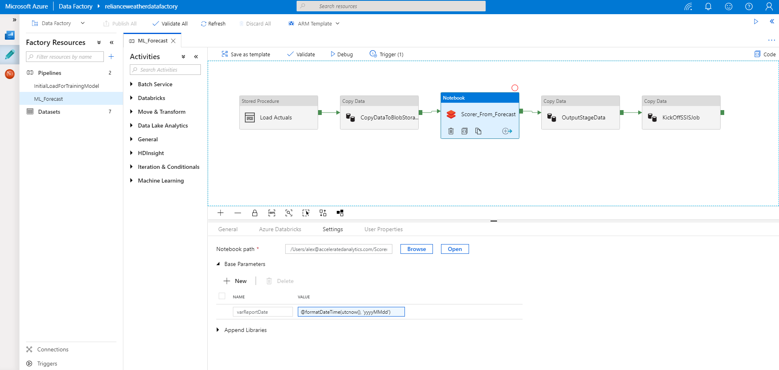
Databricks + Azure Data Factory

Slide 13



API Serving using MMLSpark
Linux VM
External Application
API
Peering
(Could by an App, Python process, etc.)
VM VNET
Workers VNET

Slide 14
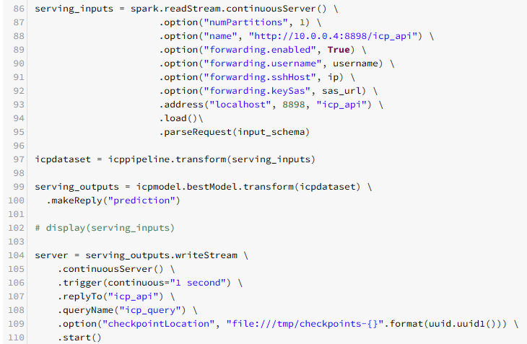
API Serving Example
From the CHOA ICP PoC

Slide 15
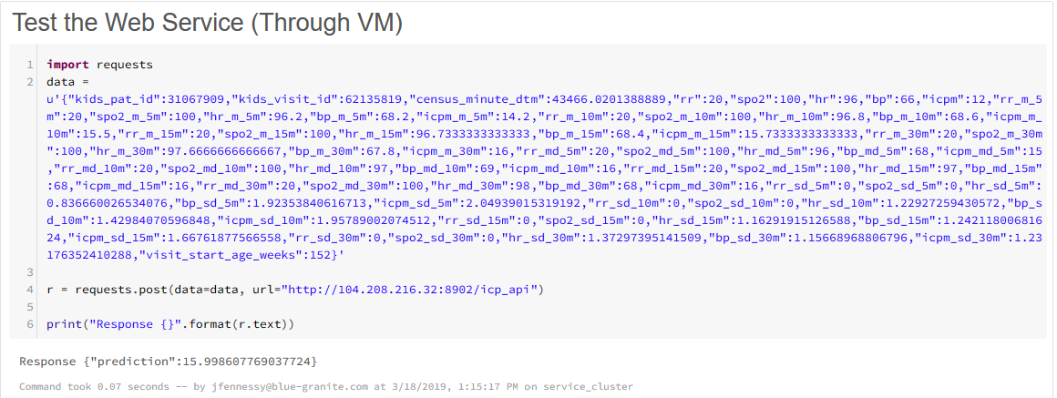
API Serving Example
From the CHOA ICP PoC

Slide 16
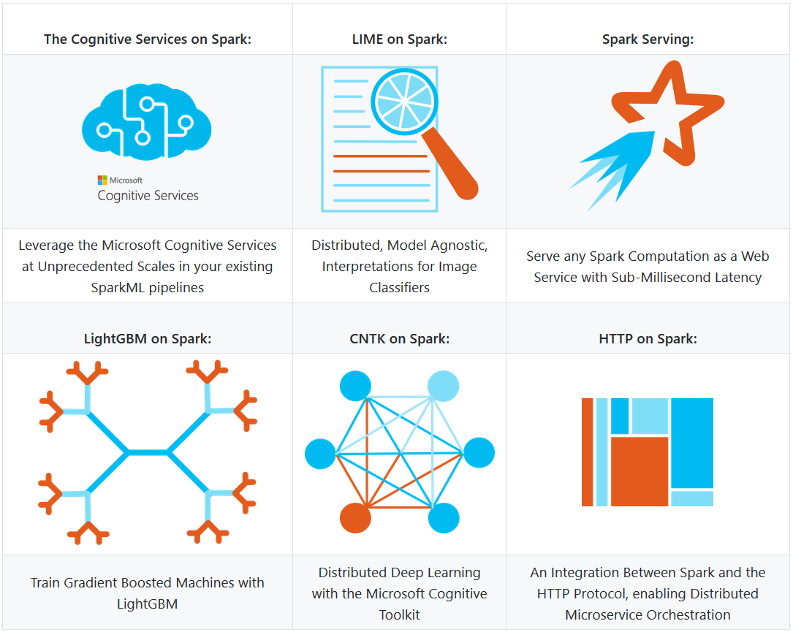
Other Features of MMLSpark
https://github.com/Azure/mmlspark

Slide 17
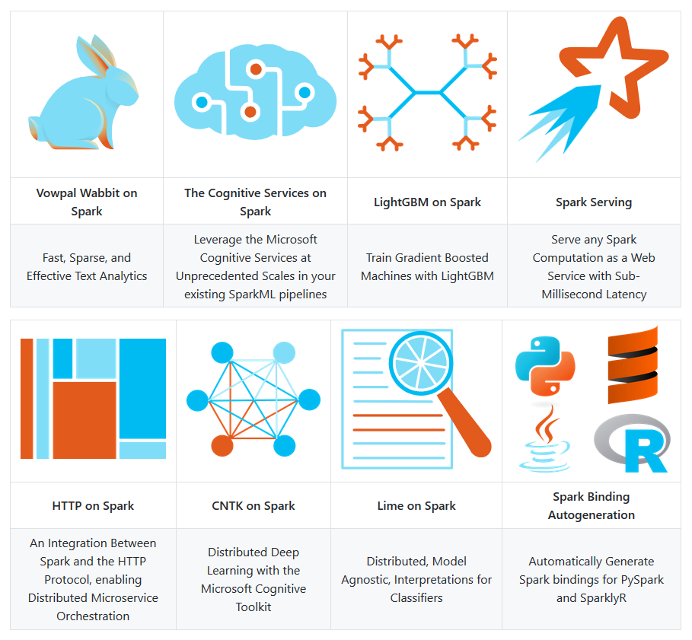
Other Features of MMLSpark
https://github.com/Azure/mmlspark

Slide 18
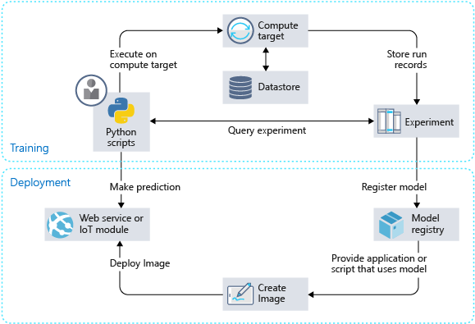
Deployment on Azure Machine Learning Service
The workflow generally follows this sequence:
Develop machine learning training scripts in Python.
Create and configure a compute target.
Submit the scripts to the configured compute target to run in that environment.
Query the experiment for logged metrics from the current and past runs.
After a satisfactory run is found, register the persisted model in the model registry.
Develop a scoring script.
Create an image and register it in the image registry.
Deploy the image as a web service in Azure.
https://docs.microsoft.com/en-us/azure/machine-learning/service/how-to-deploy-and-where

Slide 19
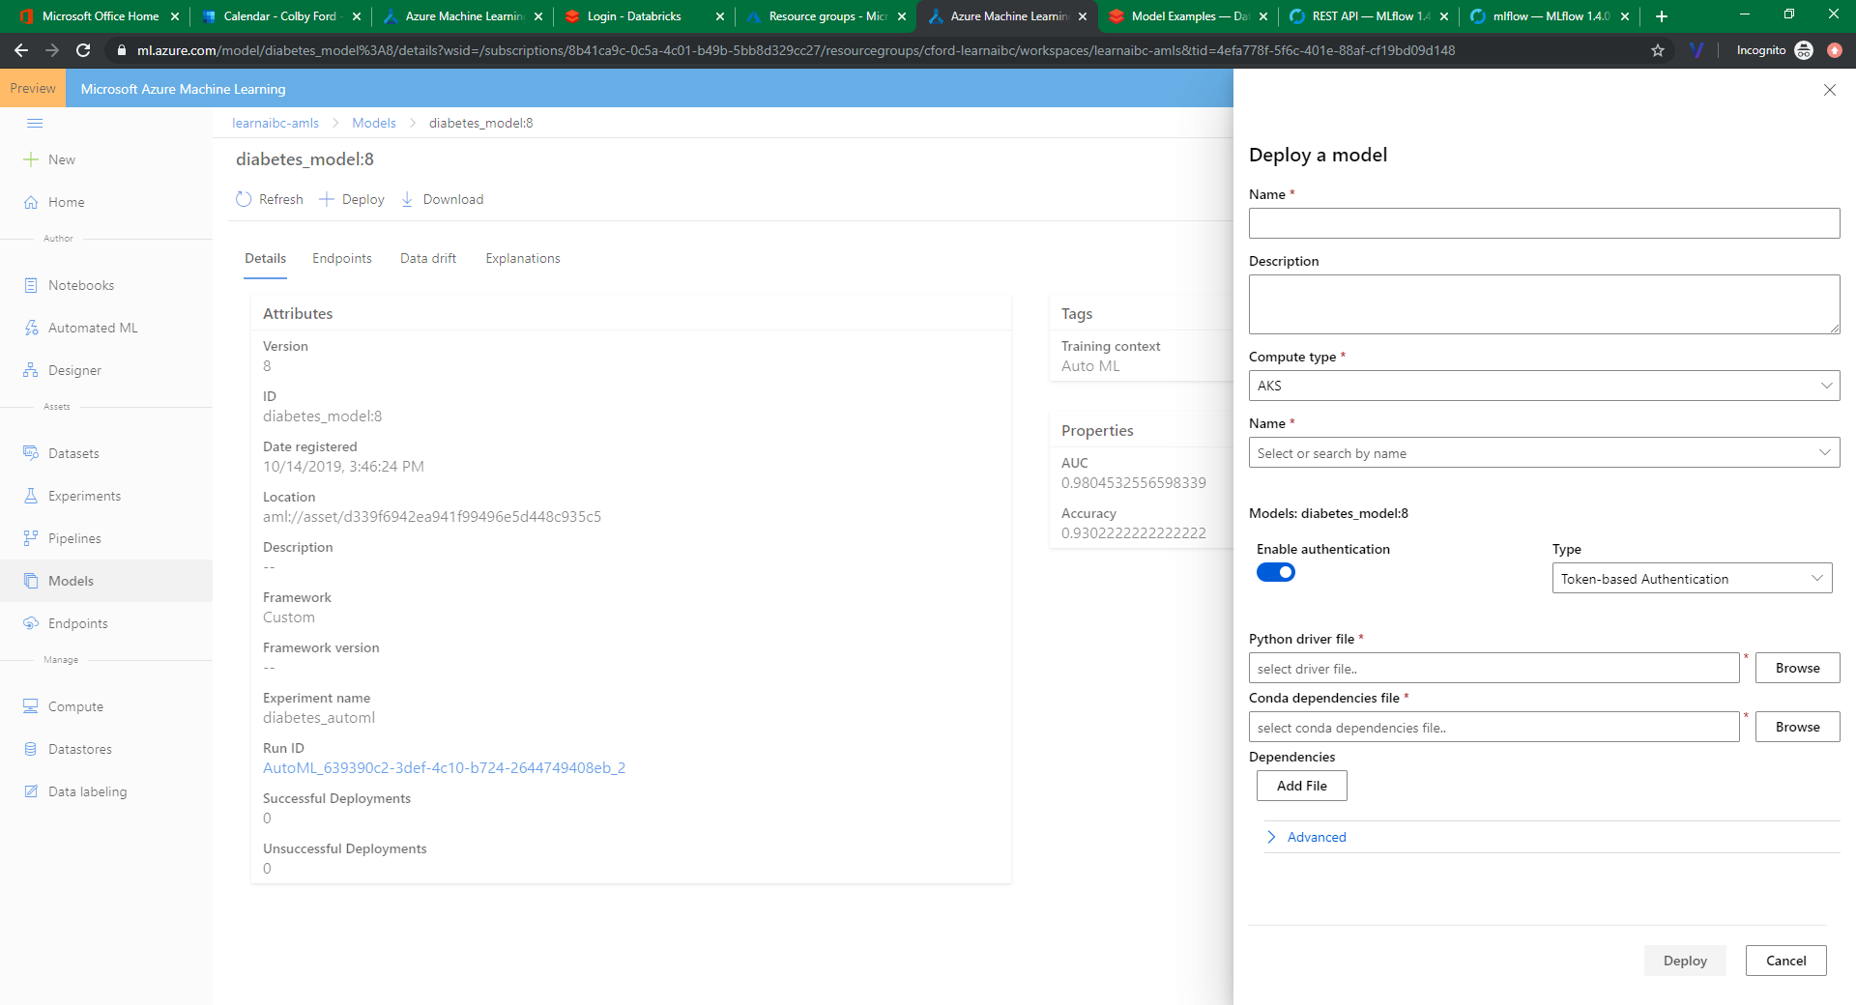
Containerized Deployment in AMLS

Slide 20
Where Can We Deploy This Stuff (in Azure)?
Model was Created Using… | I Can Deploy…
Databricks or normal Spark (MLlib, H₂O Sparkling Water, etc.) | As a Batch Service: As a Databricks Job Using ADFv2 to Call Scoring Jobs As a Realtime Webservice: MMLSpark In Synpase? Score as part of a query using a Spark Pool
Some other Python Package (sklearn, Keras, Pytorch, etc.) | AMLS as a Realtime Webservice: AKS/ACI Azure IoT Edge FPGAs AMLS as a Batch Service: AML Compute Function as an API
Some other R Package | ☹ (Maybe using custom deployment with Functions) *R SDK for AMLS Once Updated?

Slide 21
Overview
Azure OpenAI Service
Other Cluster Technologies
Intro to Deep Learning
Deep Learning Frameworks
Overview of Neural Networks
Processors

Slide 22
Goals:
Understand what neural networks are.
Understand why you need to use GPUs to train them.
Understand why the cloud might be a good place to do so.

Slide 23
Other Cluster Technologies
Parallel Virtual Machine (PVM)
Only for low-level languages like FORTRAN, C, and C++
Oak Ridge National Laboratory, 1989
Message Passing Interface (MPI)
Only for low-level languages, but plenty of interfaces to higher-level languages like R, Python, Java, etc.
Most popular today.
Dongarra, et al., 1992
Scalable Network of Workstations (SNOW)
Only for R
Tierney, et al., 2009
Common themes:
Multiple machines connected together (ethernet, infiniband, etc.)
Parallelism is based on cores across the cluster
Sharing resources like memory, HDD, CPUs, GPUs, etc.

Slide 24
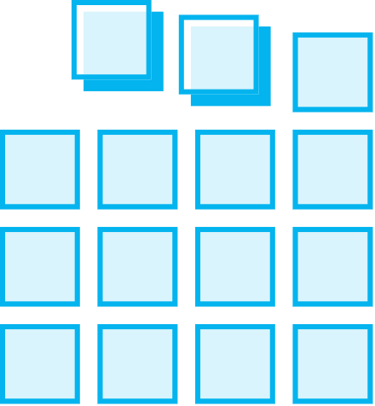
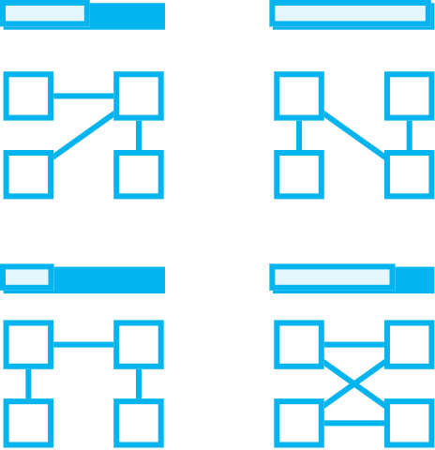
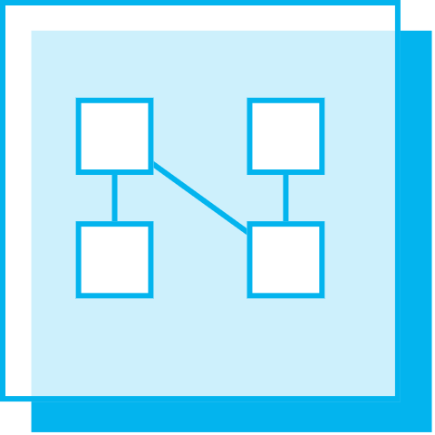

Intro to Machine Learning
Deep
Prepare Data
Build & Train
Deploy
Connect to various sources to ingest data
Train with the data to establish a model
Deploy the model and track performance

Slide 25
Deep Learning Frameworks
TensorFlow
CNTK
MXNet
Microsoft
Google
Apache
PyTorch
Chainer
Facebook
Caffe2
Berkeley
Keras
François Chollet
Preferred Networks
Theano
University of Montreal

Slide 26

Deep Learning Options in the Cloud
Databricks
Machine Learning
DLVM

Slide 27
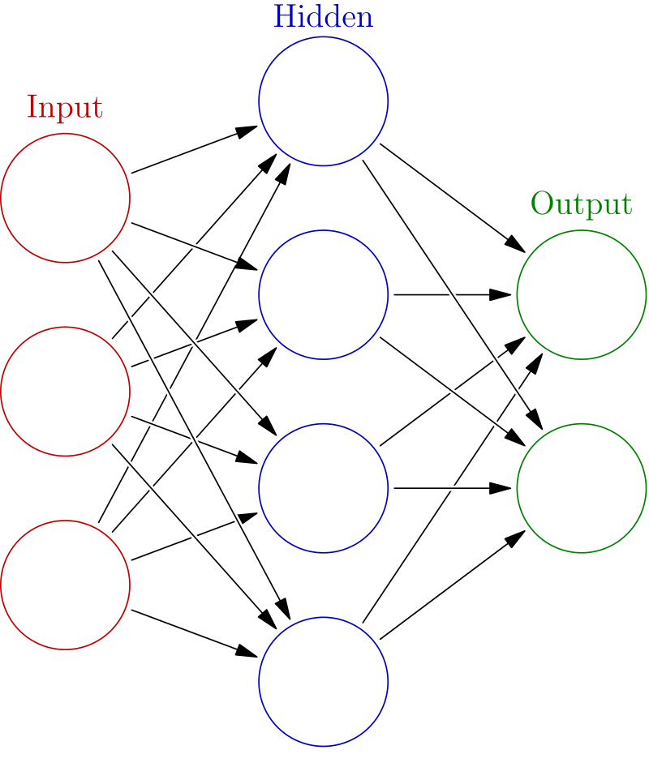
Overview of Neural Networks
Built using interconnected nodes in multiple layers
Layers:
Input:
The set of input features
Hidden:
Set of mathematical functions to compute activations
Output:
The predicted class or value
Connections:
Directional weights
Examples:
Recurrent Neural Networks
Useful for NLP
Convolutional Neural Networks
Useful in Image Recognition
Long Short-Term Memory
Useful for Time Series
…tons more
“Deep” just means there are multiple layers…
https://commons.wikimedia.org/w/index.php?title=File:Colored_neural_network.svg&oldid=279111871
16:07

Slide 28

http://www.asimovinstitute.org/neural-network-zoo/

Slide 29

ONNX
Open Neural Network Exchange
An open-source, standardized format for describing neural network models [*.onnx]
Helps in usability when the model object is framework-agnostic
Model Zoo: a place to publish your trained model for open, external use

Slide 30
Types of Processors (Well, the ones relevant to ML/DL/AI)
Central Processing Unit
1-32 Cores
up to ~5GHz
Single precision (32-bit), Double precision (64-bit) and possibly Extended precision (128-bit)
Graphics Processing Unit
100s-1000s of slower cores
~500-1200MHz
Field Programmable Gate Array
Reconfigurable chips to do a specific task – using programmable logic blocks
Tensor Processing Unit
Developed by Google (especially for use in TensorFlow).
High volume, low precision (8-bit)
Proprietary, but can be used on GCP
Useful in IoT/Edge scenarios
Single precision to Double precision

Slide 31
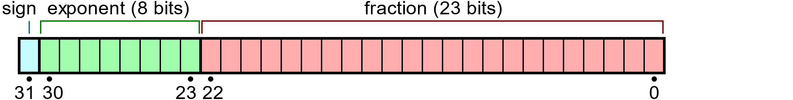
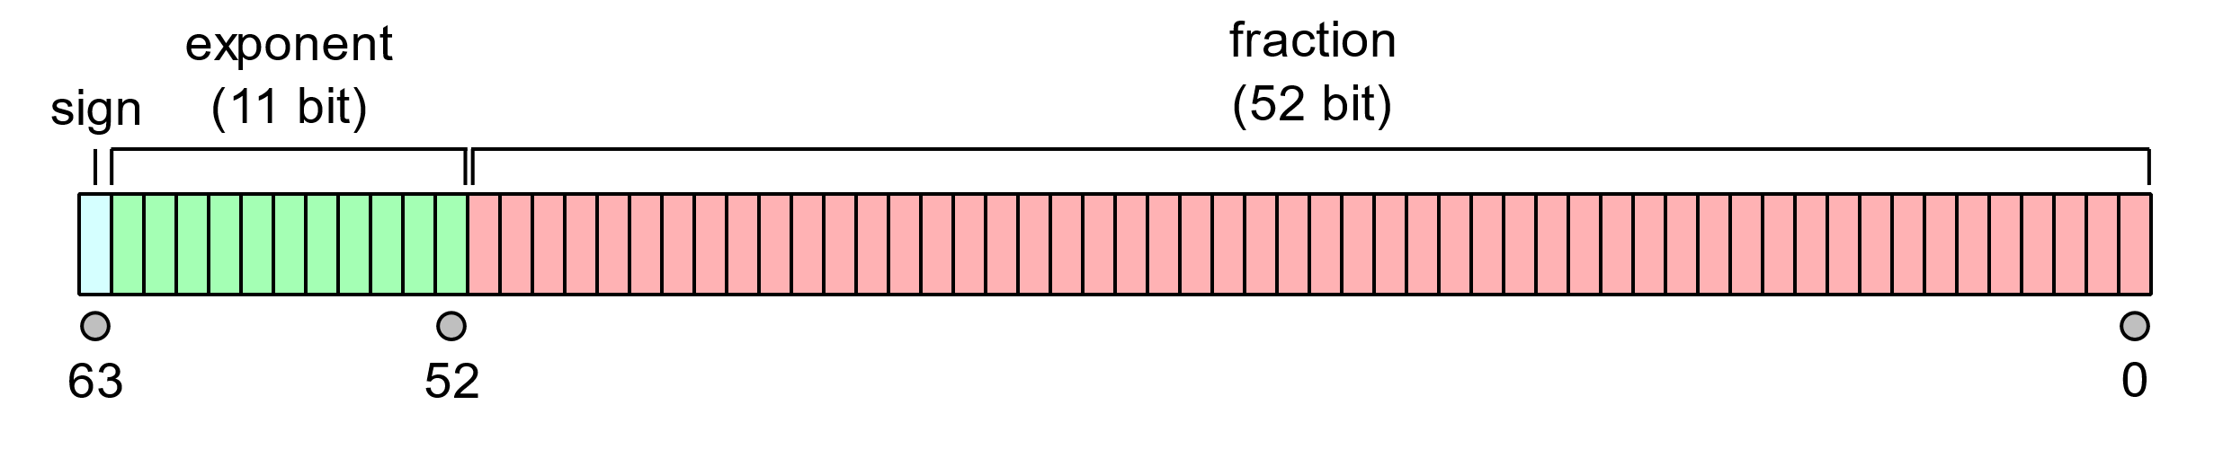
Precision, Precisely
Single Precision
Max Signed Integer Value: 2³¹ − 1 = 2,147,483,647
Max IEEE 754 Value: (2 − 2⁻²³) × 2¹²⁷ ≈ 3.4028235 × 10³⁸
Significant Digits: up to 9
Double Precision
Max Signed Integer Value: 2⁶³ − 1 = 9,223,372,036,854,775,807
Max IEEE 754 Value: (2 − 2⁻⁵²) × 2¹⁰²³ ≈ 1.7976931 × 10³⁰⁸
Significant Digits: up to 17
Binary32 Example
Input: 3.14159265358
Stored as: 3.1415927410125732421875
Error: 8.74325732421875E-8
Binary: 0 10000000 10010010000111111011011
Binary64 Example
Input: 3.14159265358
Stored as: 3.1415926535800000607423498877324163913726806640625
Error: 6.07423498877324163913726806640625E-17
Binary: 0 10000000000 1001001000011111101101010100010000111101011011110100
Notes:
Fun fact: The “fraction” part of the IEEE Value is called the “Mantissa”

Slide 32


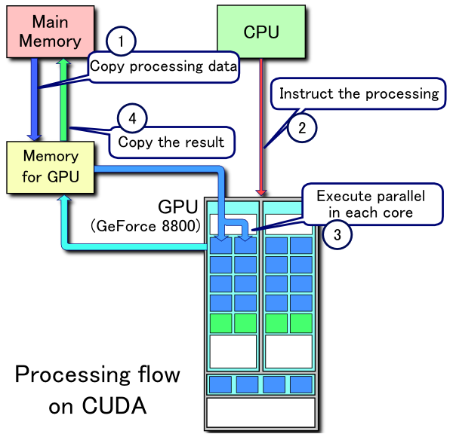
CUDA and OpenCL
CUDA
Developed by Nvidia
For use on Nvidia or CUDA-enable GPUs
Parallelized functionality for linear algebra, sparse matrices, Fourier transforms, random numbers, solvers, graph processing, and more.
OpenCL
Originally developed by Apple, maintained by the Khronos Group
For use in CPUs, GPUs, and FPGAs (for a variety of vendors)
Parallelized functionality for matrix algebra, vectors (especially images)
CUDA Processing Flow by Tosaka [CC BY 3.0 (https://creativecommons.org/licenses/by/3.0)]

Slide 33
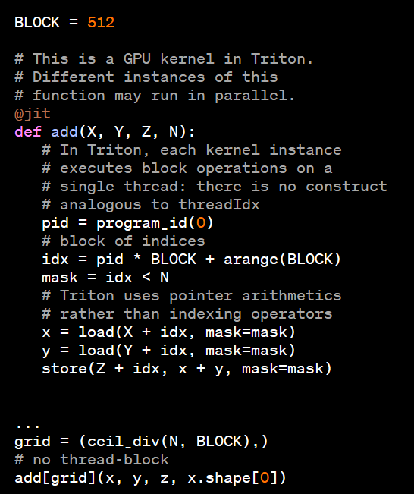


Triton and Metal
Triton
Developed by OpenAI
For use on virtually any GPU
Technically a language and compiler
Primitives for custom deep learning functionality
Metal
Developed by Apple
For use across Apple hardware (integrated M chips with both CPU and GPUs)
Mainly for gaming, but now has a backend for PyTorch
“Triton makes it possible to reach peak hardware performance with relatively little effort; for example, it can be used to write FP16 matrix multiplication kernels that match the performance of cuBLAS—something that many GPU programmers can’t do—in under 25 lines of code. Our researchers have already used it to produce kernels that are up to 2x more efficient than equivalent Torch implementations, and we’re excited to work with the community to make GPU programming more accessible to everyone.”

Slide 34
Keras Model Walkthrough
IMDB Dataset
Models and Compiling
Layers
Fit, Save, and Show

Slide 35
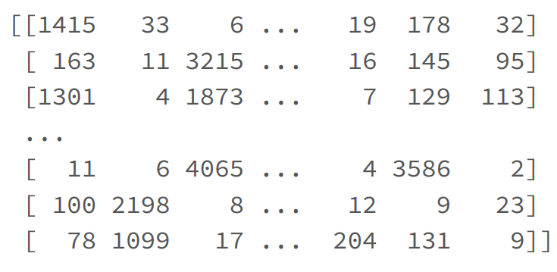
IMDB Dataset
Dataset of 25,000 movies reviews from IMDB, labeled by sentiment (positive/negative). Reviews have been preprocessed, and each review is encoded as a sequence of word indexes (integers).
For convenience, words are indexed by overall frequency in the dataset, so that for instance the integer "3" encodes the 3rd most frequent word in the data. This allows for quick filtering operations such as: "only consider the top 10,000 most common words, but eliminate the top 20 most common words".

Slide 36
Models and Compiling
Sequential – a linear stack of layers. Specify input shape and then add layers
model = Sequential()
model.add(Dense(32, input_shape=(16,)))
model.add(Conv2D(64, (3,3), activation…)
Compiling – set up the performance settings of the model.
Optimizer:
Stochastic gradient descent, RMSprop
Adagrad, Adadelta, Adamax
Adam, Nadam
Loss Function:
Mean squared error, mean absolute error, mean absolute percentage error, mean squared logarithmic error
Hinge, squared hinge
Kullback-Leibler divergence
Logcosh, cosine proximity
Cross entropy
Other Metrics:
Accuracy
model.compile()

Slide 37
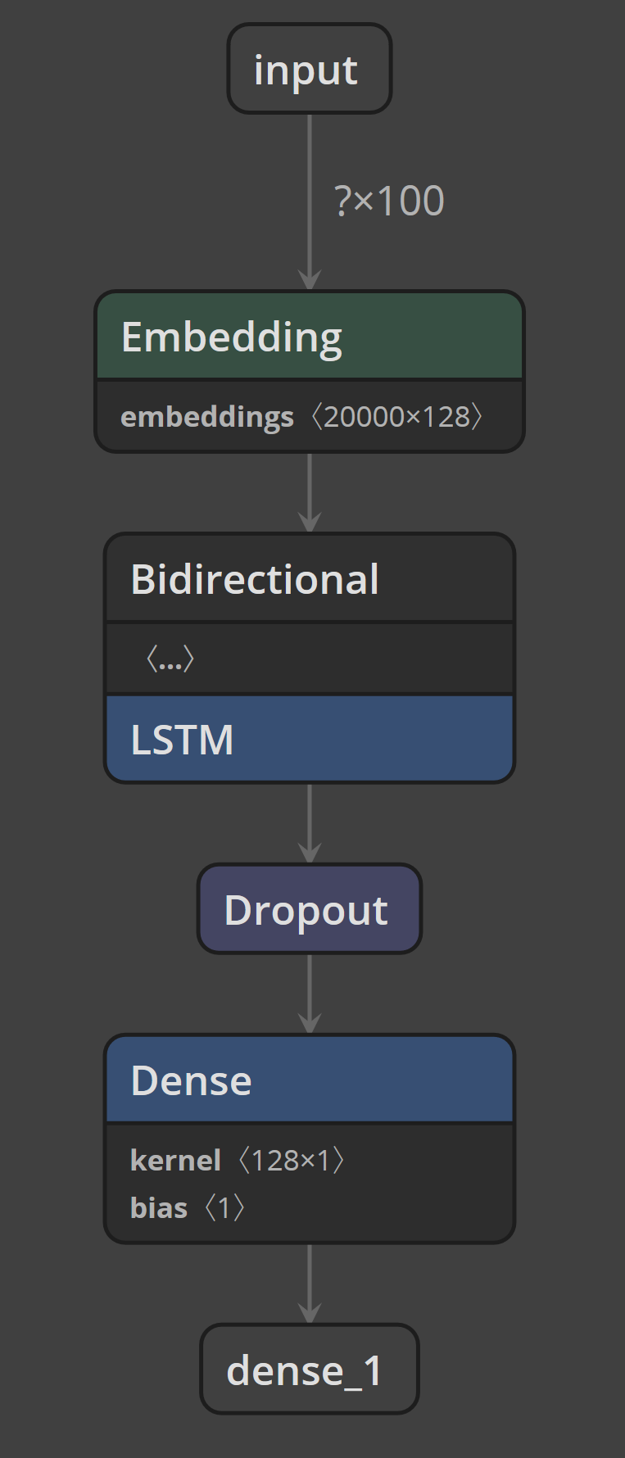
Layers
model.add(Embedding(max_features, 128, input_length=maxlen))
Turns positive integers (indexes) into dense vectors of fixed size.
model.add(Bidirectional(LSTM(64)))
Bidirectional means that the process can move forward and backward.
LSTM creates a ‘long short-term memory’ RNN of a specified size.
model.add(Dropout(0.5))
Dropout consists in randomly setting a fraction (rate) of input units to 0 at each update during training time, which helps prevent overfitting.
model.add(Dense(1, activation='sigmoid'))
The dense layer is fully connected layer, so all the neurons in a layer are connected to those in a next layer.
http://colah.github.io/posts/2015-08-Understanding-LSTMs/

Slide 38
Fit, Save, and Show
CNN Example
Netron
model.fit(x_train, y_train,
batch_size=batch_size,
epochs=4,
validation_data=[x_test, y_test])
Batch size: number of samples per gradient update
Epochs: Number of iterations over the entire x & y data
from keras.models import load_model
# save to the local filesystem
model.save('/tmp/imdb_lstm_model.h5’)
# move to a for future use
dbfs_model_path = 'dbfs:/mnt/general/trainedmodels/dl/imdb_lstm_model.h5’
dbutils.fs.cp('file:/tmp/imdb_lstm_model.h5', dbfs_model_path)

Slide 39
…
Hint: The importance value set between nodes of different layers
Hint: The math function that makes a neuron “light up”

Slide 40
Hidden Layers
Input Layer
Output Layer
…
Node
Weight
Activation
Hint: The importance value set between nodes of different layers
Hint: The math function that makes a neuron “light up”

